Slide 1

INVERSE PENDULUM SWING-UP PROBLEM: Reinforcement Learning Approach
CMSE 890 (AML) Course Project By Arman Khoshnevis

Slide 2
Agenda
Problem Description
Applications
Introduction
Basic Concepts
Policy-Based vs. Value-Based Approaches
Exploration vs. Exploitation
Bellman Equation & TD Learning
Q-Learning
Q-Learning with Linear Function Approximation
Deep Q-Network
Results
Q-Learning (Unsuccessful)
DQN (Successful)
DQN (Unsuccessful)
Future Work
Deep Deterministic Policy Gradient (DDPG)
References

Slide 3
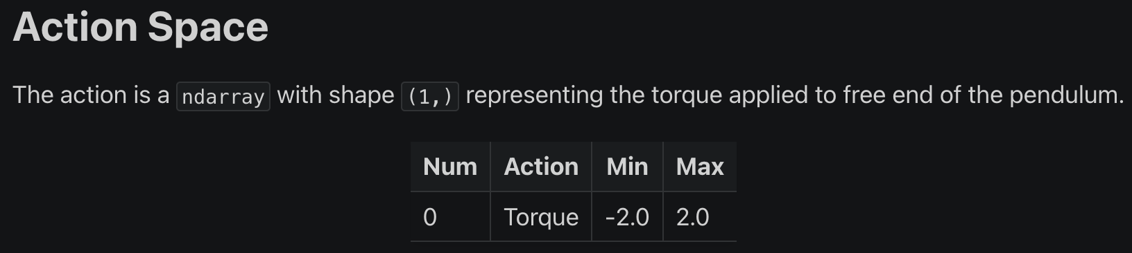
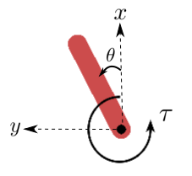
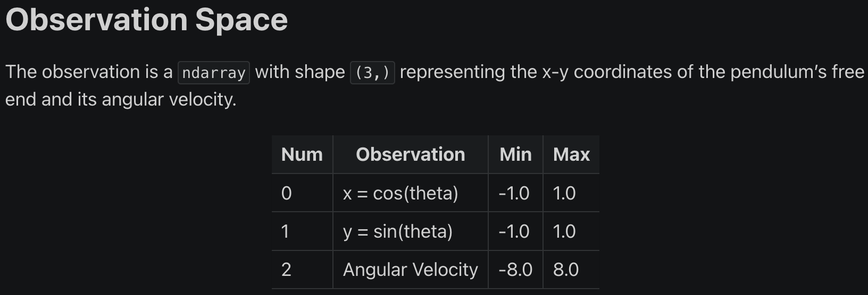

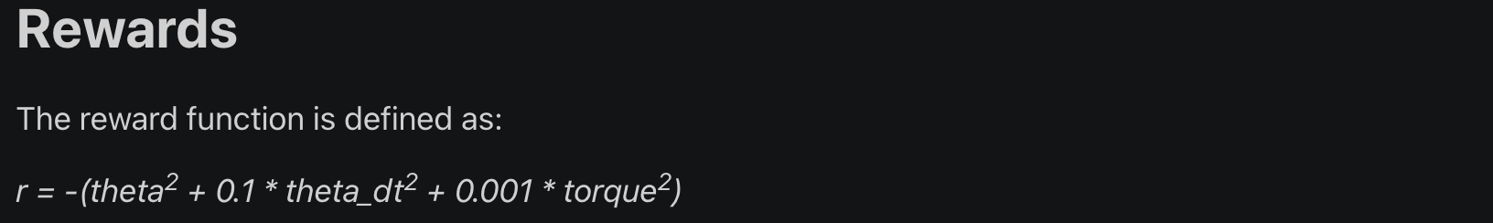


Problem Description
Pendulum Swing-Up Problem (Pedulum-v1)

Slide 4
Problem Description
Traditional Controller: Precise mathematical modeling, Feedback controller like PID
Highly Non-Linear and Unstable Systems
Unavailable or Imprecise Models
Control Methods based on Artificial Intelligence:
Reinforcement Learning: Interaction between an agent and its environment
Model free!
Objective:
Implement various RL algorithms (from simple to complex) on this benchmark problem
Ultimate Application:
Boston Dynamics! and many more

Slide 5
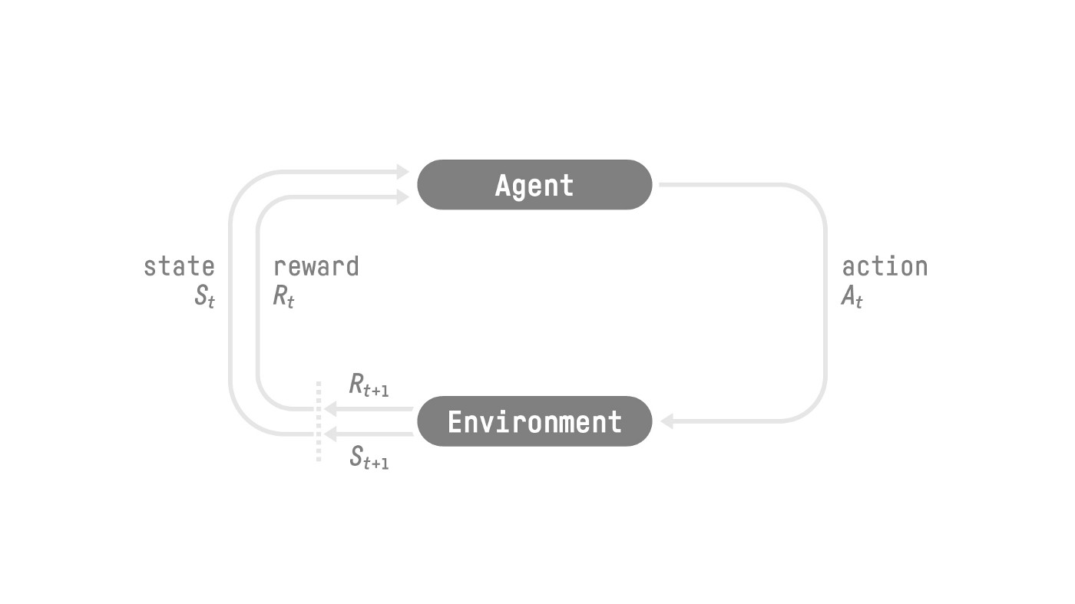
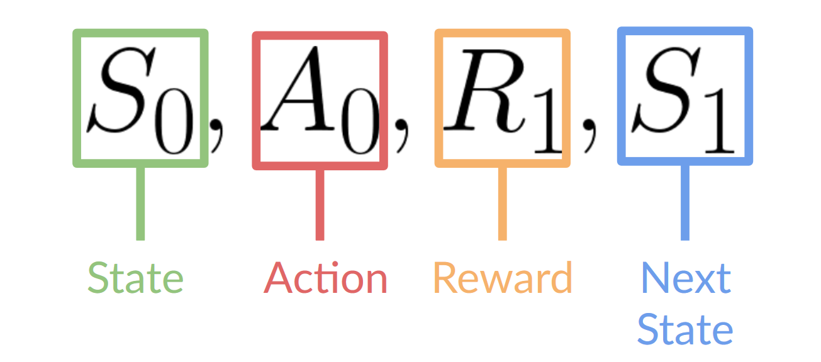
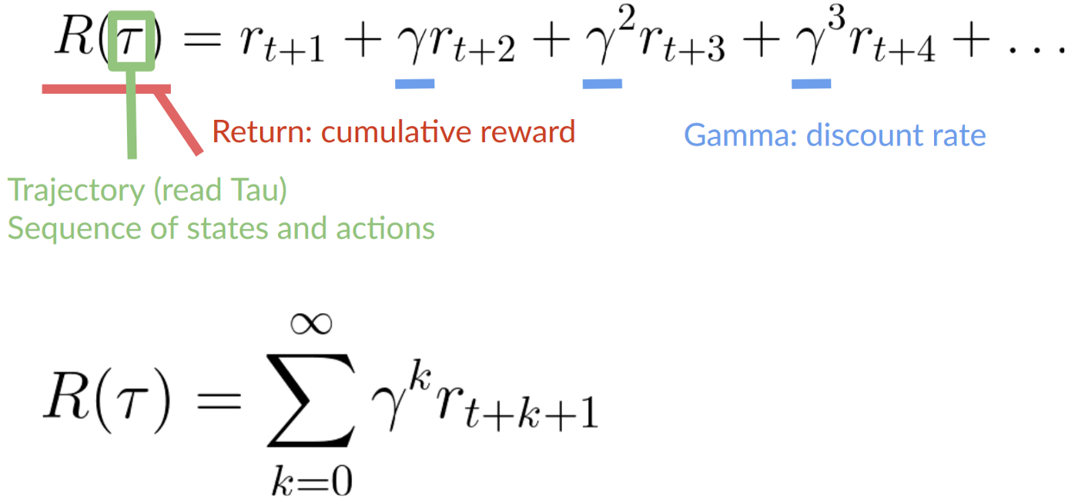
Introduction: Terminologies
Reinforcement Learning: An agent learns from the environment by taking actions (trial and error process) and receiving rewards (negative or positive) as feedback.
Goal: Maximize the expected cumulative reward.
State: A complete description the environment.
In the present problem, both concepts are identical!
Observation: A partial description of the environment.
Action Space: A set of all possible actions in the environment: Continuous/Discrete
Reward: A feedback received by the agent.
Balance between short- and long-term reward $→$ Discount factor: $0<γ<1$ (mostly $0.95<γ<0.99$)

Slide 6
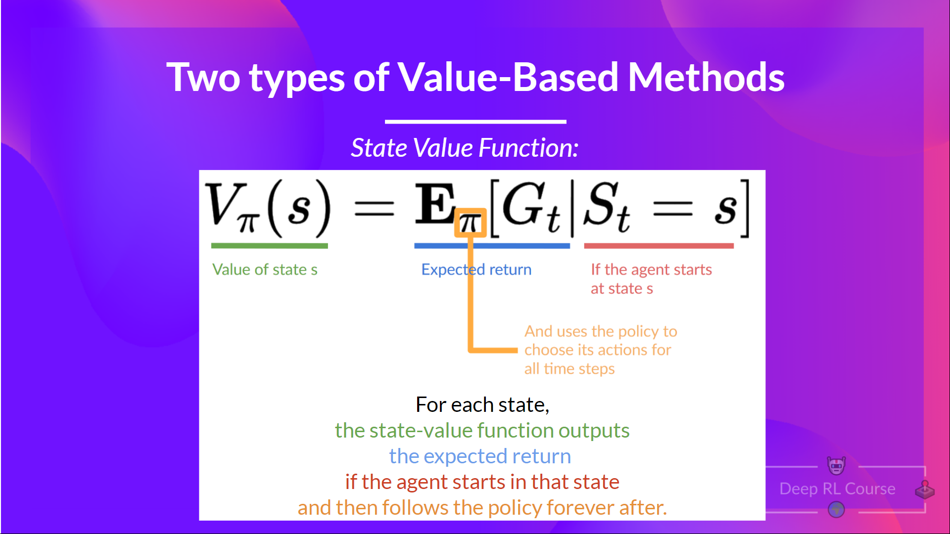
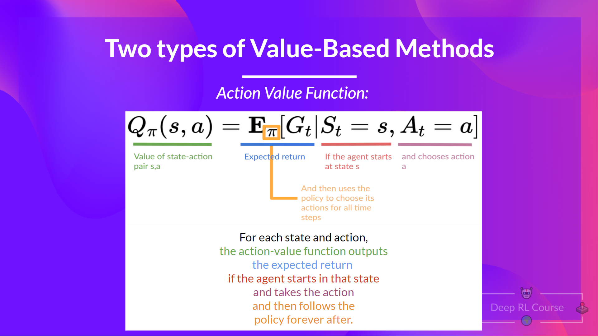
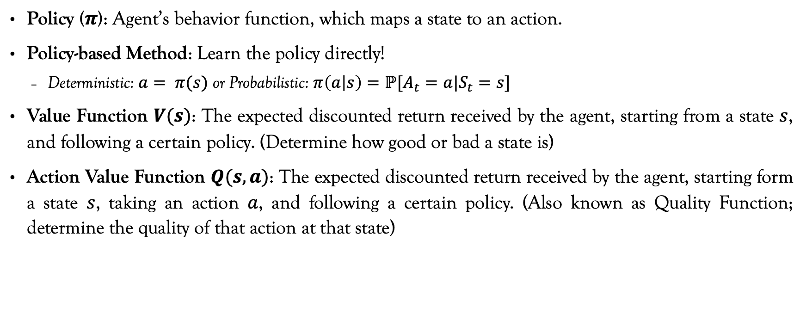
Introduction: Policy-Based vs. Value-Based Approaches
Policy ($π$): Agent’s behavior function, which maps a state to an action.
Policy-based Method: Learn the policy directly!
Deterministic: $a= π(s)$ or Probabilistic: $π\left(a | s\right)=ℙ[A_{t}=a|S_{t}=s]$
Value Function $V(s)$: The expected discounted return received by the agent, starting from a state $s$, and following a certain policy. (Determine how good or bad a state is)
Action Value Function $Q(s,a)$: The expected discounted return received by the agent, starting form a state $s$, taking an action $a$, and following a certain policy. (Also known as Quality Function; determine the quality of that action at that state)

Slide 7
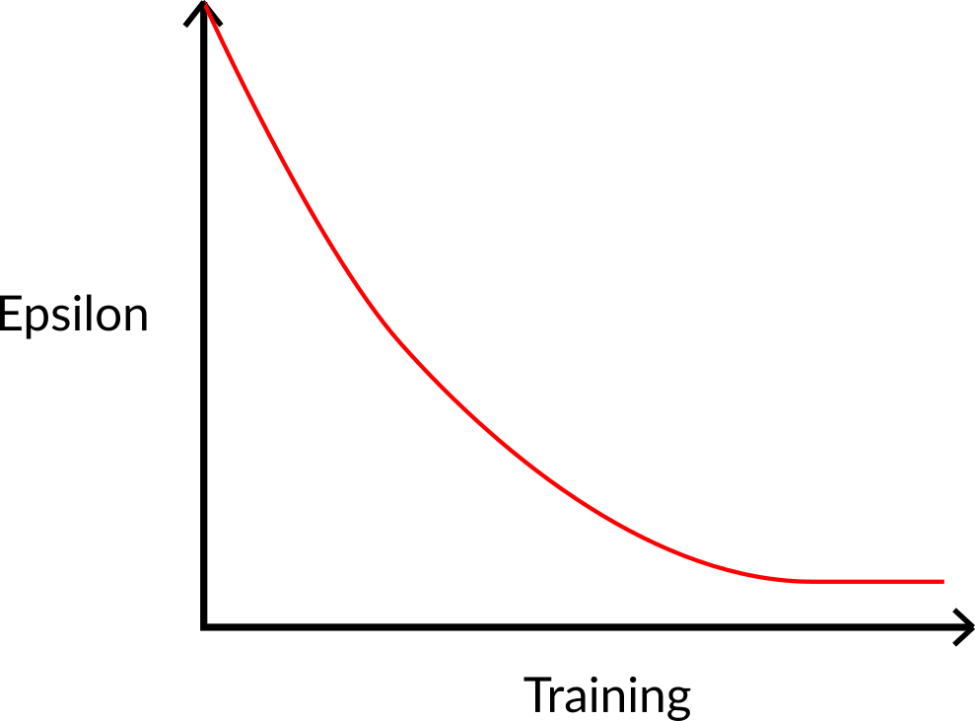
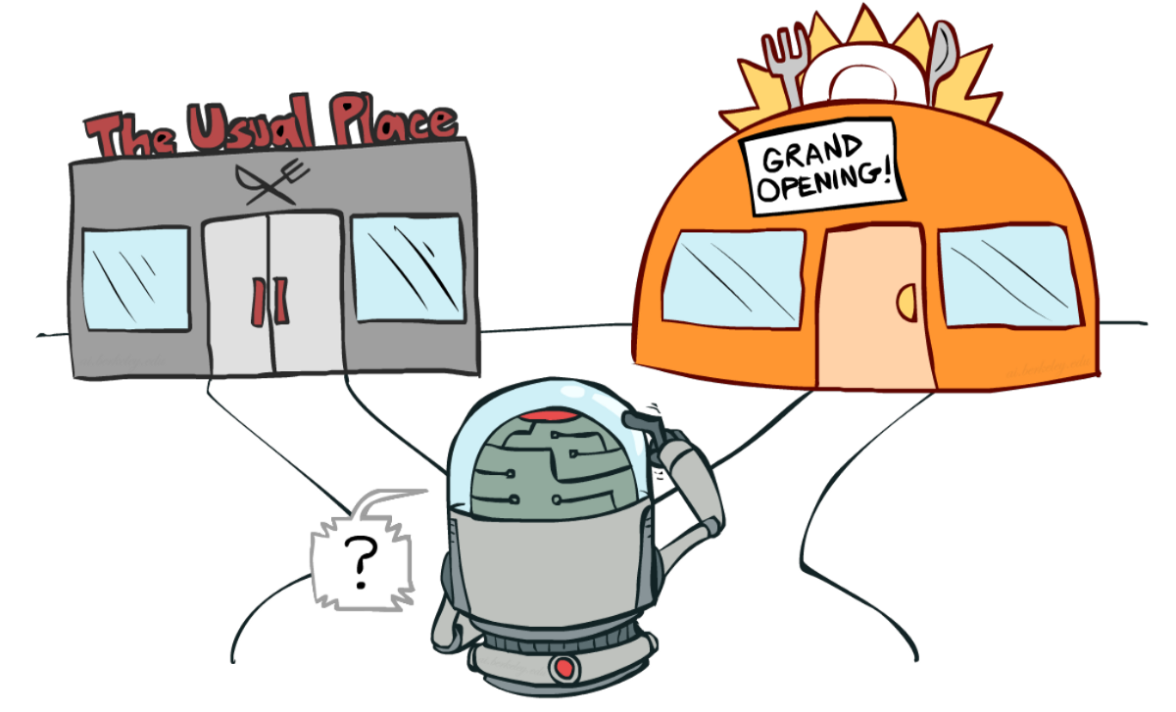
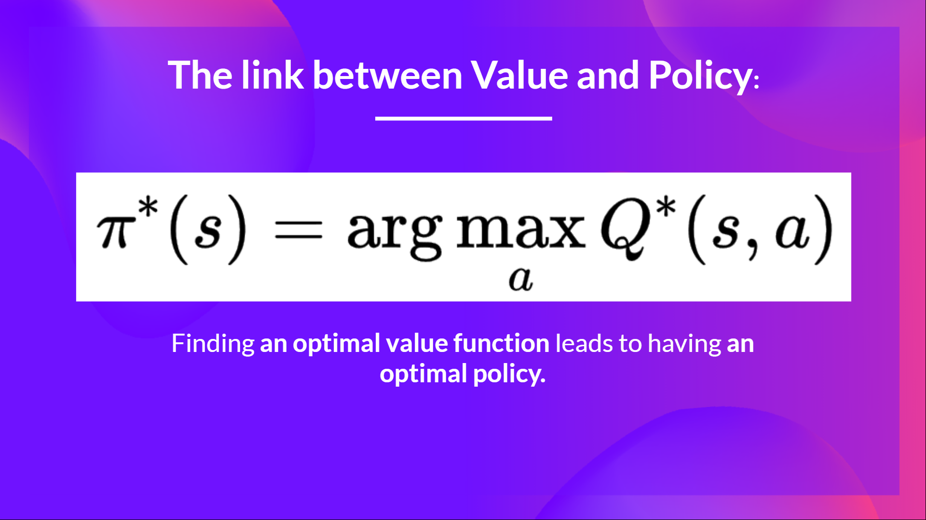
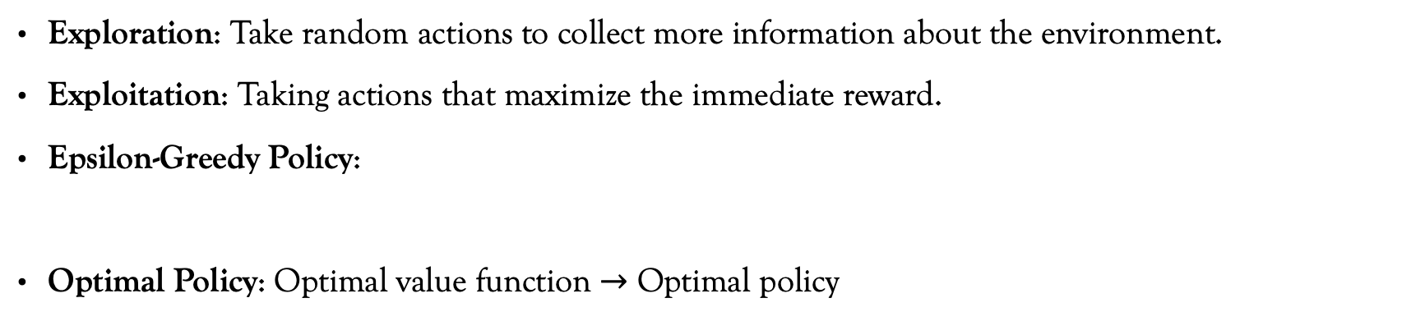
Introduction: Exploration / Exploitation Dilemma
Exploration: Take random actions to collect more information about the environment.
Exploitation: Taking actions that maximize the immediate reward.
Epsilon-Greedy Policy:
Optimal Policy: Optimal value function $→$ Optimal policy
Random action with a probability of $ε$
Action with the highest Q-value with a probability of $1−ε$

Slide 8
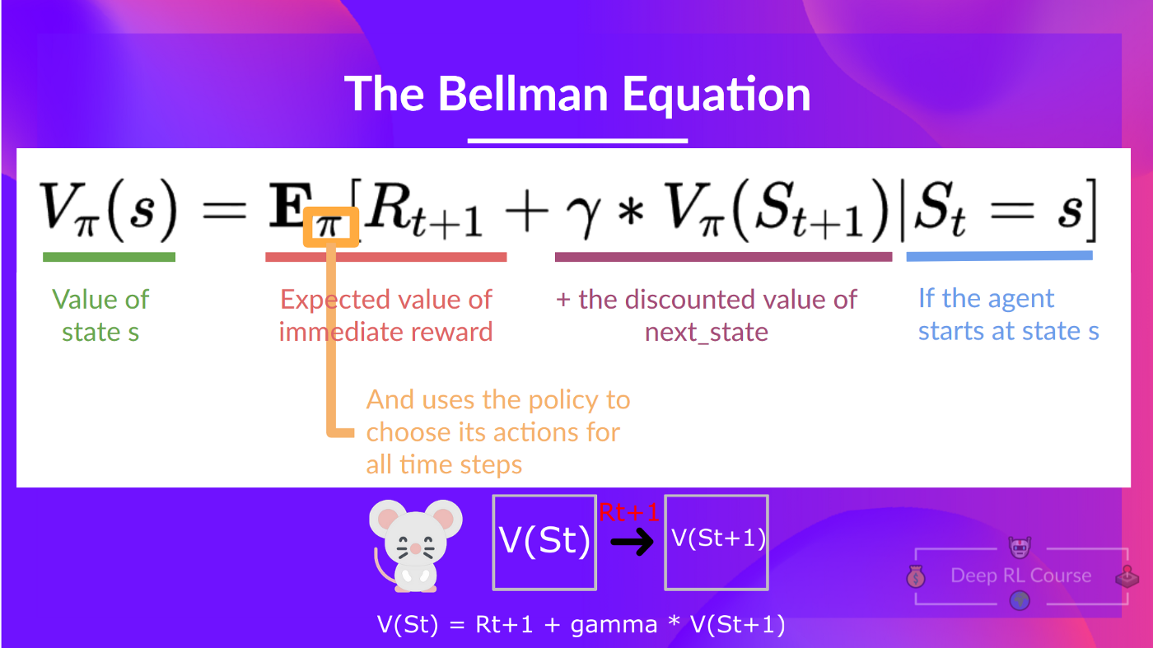
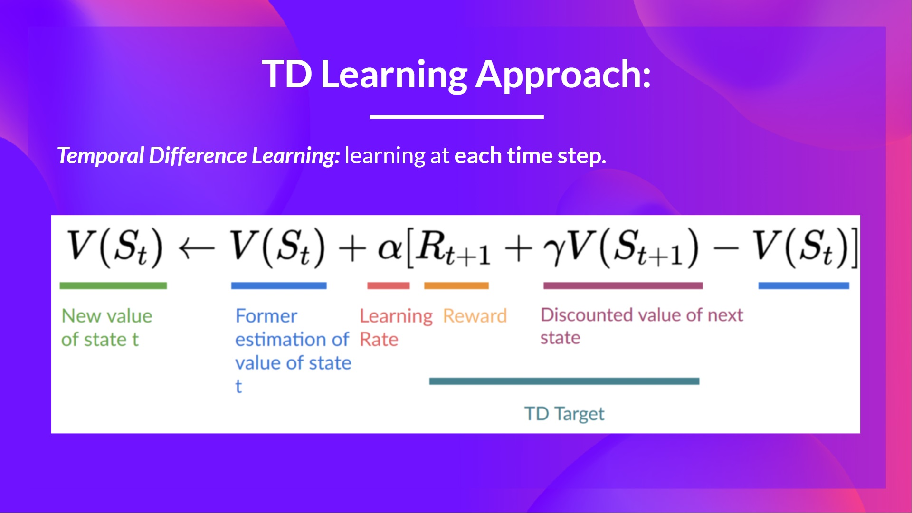
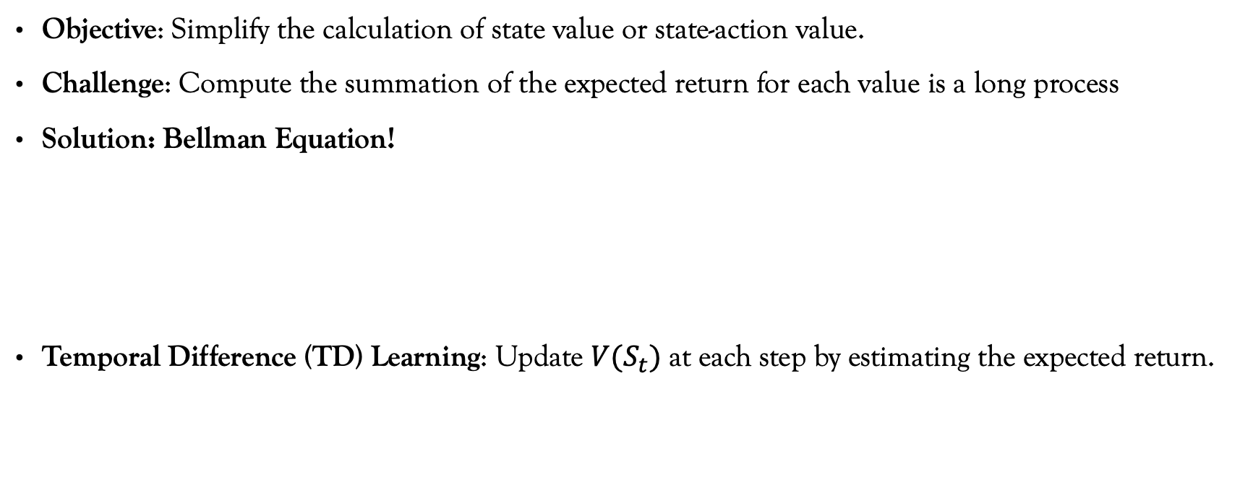
Introduction: Bellman Equation & TD learning
Objective: Simplify the calculation of state value or state-action value.
Challenge: Compute the summation of the expected return for each value is a long process
Solution: Bellman Equation!
Temporal Difference (TD) Learning: Update $V(S_{t})$ at each step by estimating the expected return.
An estimation of the expected return

Slide 9
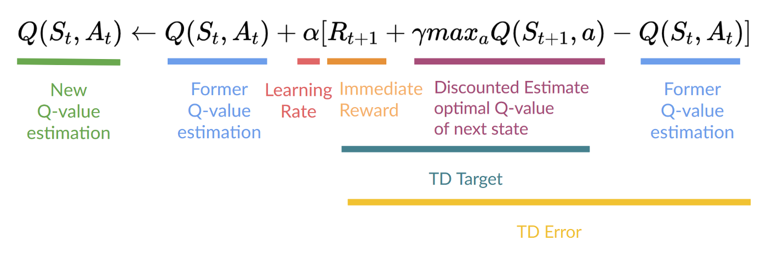
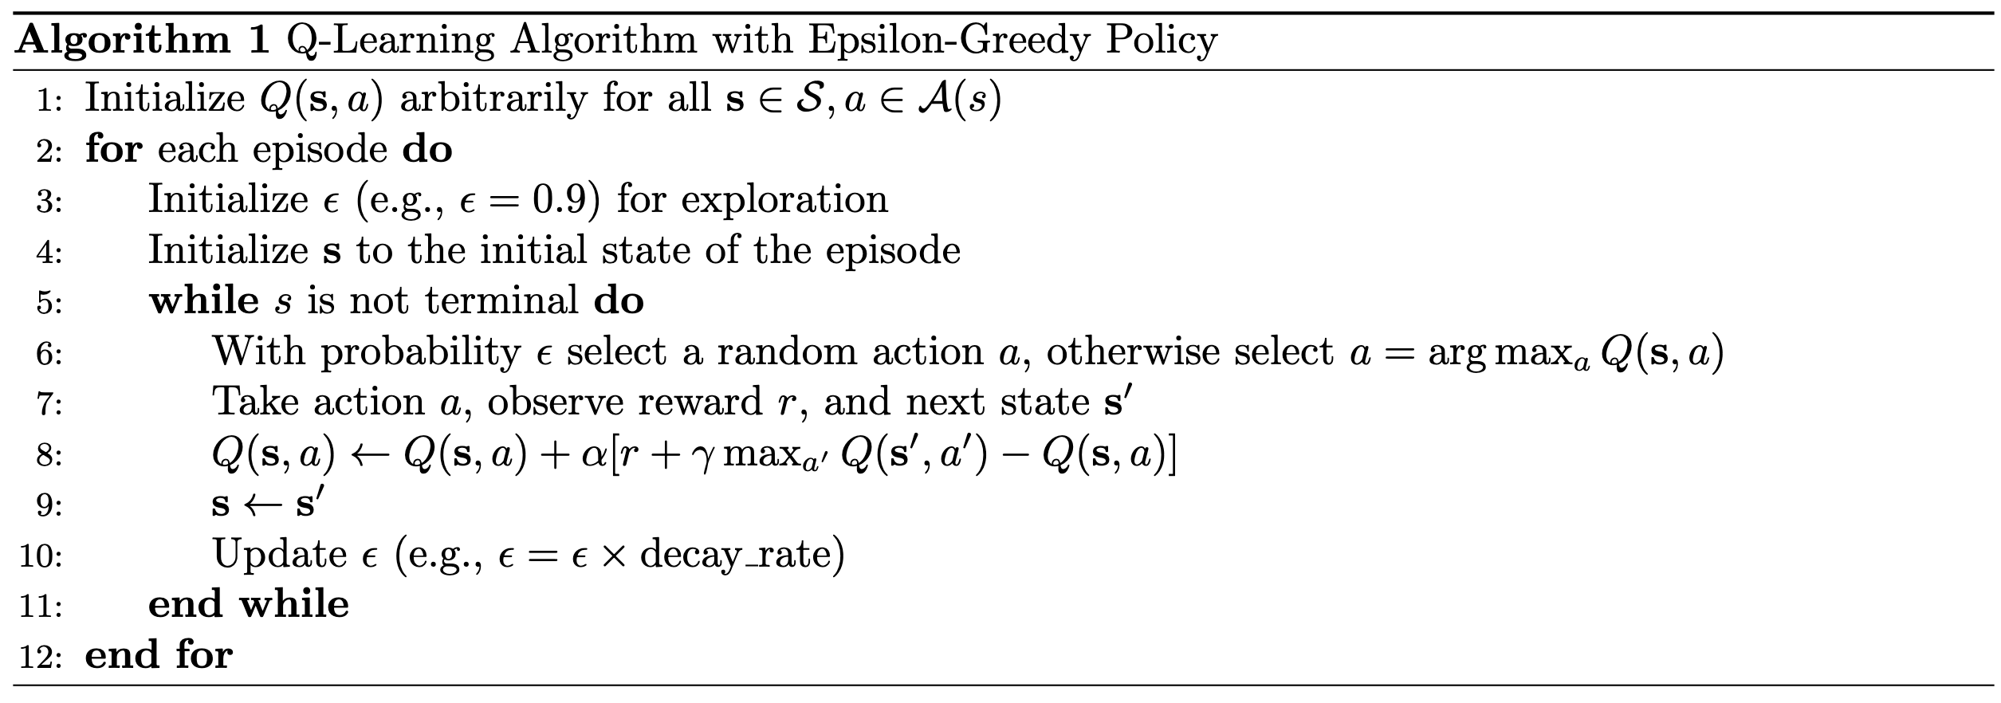
Q-Learning Algorithm
What is Q-Learning:
Value-based
Off-policy
TD Learning
Off-policy

Slide 10
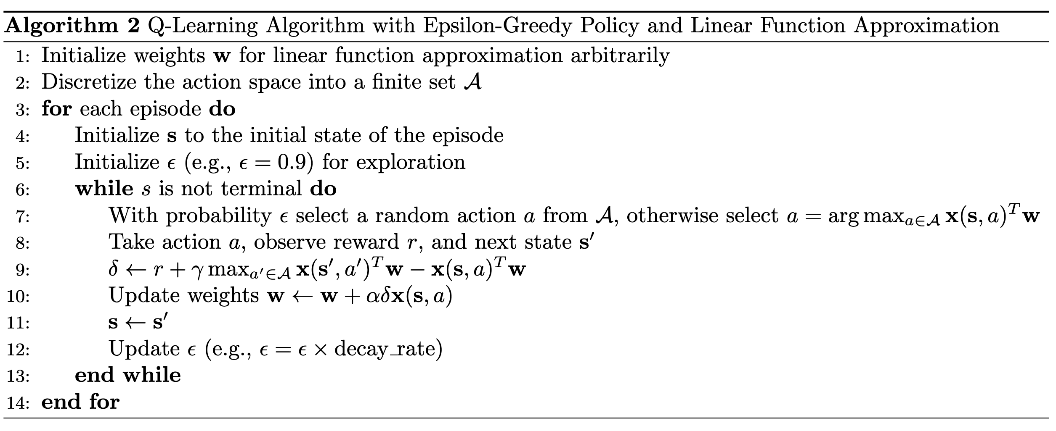
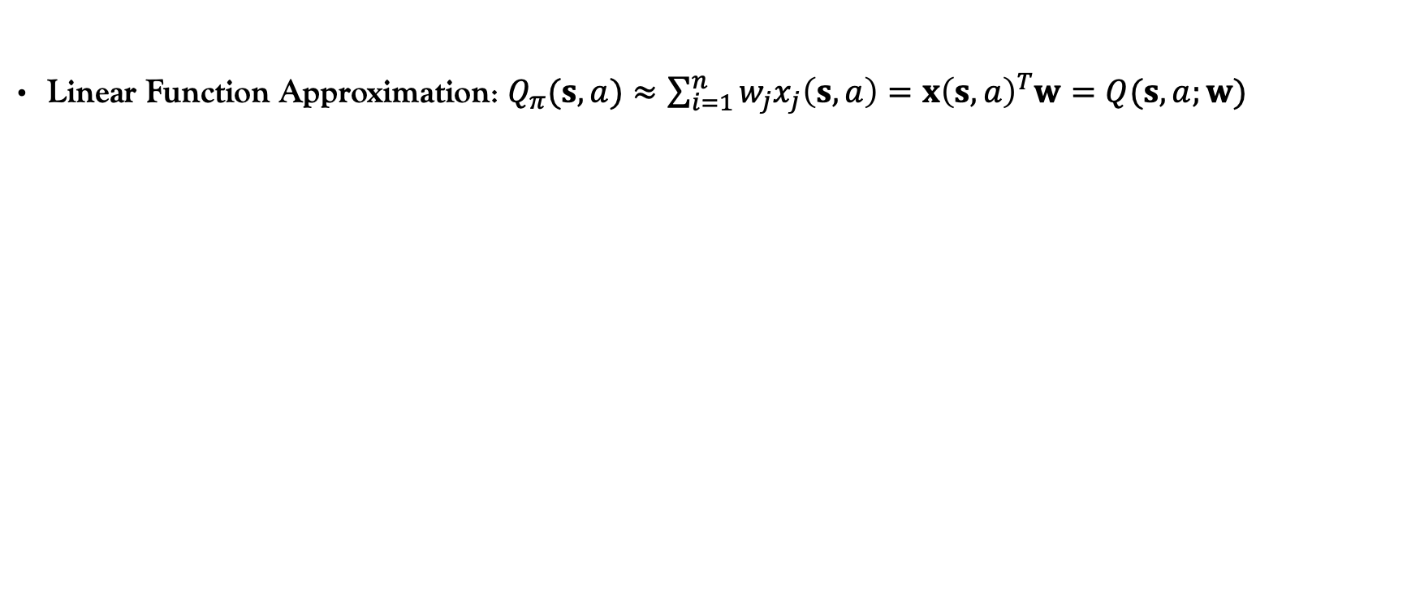
Q-Learning Algorithm; Continuous Action Space
Linear Function Approximation: $Q_{π}(s,a)≈\sum_{i=1}^{n}{w_{j}x_{j}\left(s,a\right)}=x{\left(s,a\right)}^{T}w=Q(s,a;w)$

Slide 11
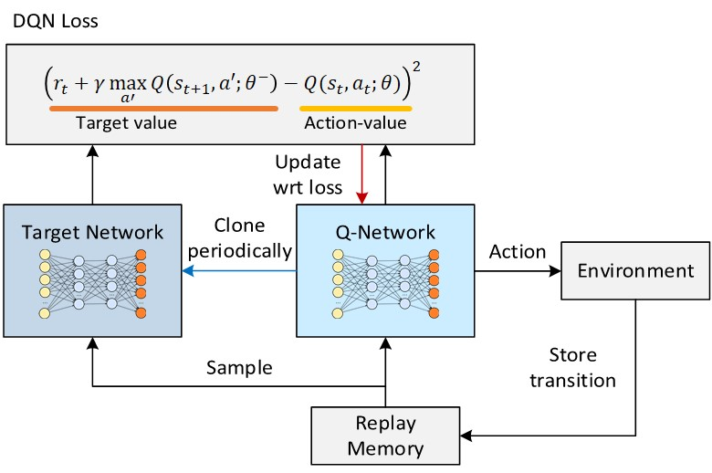
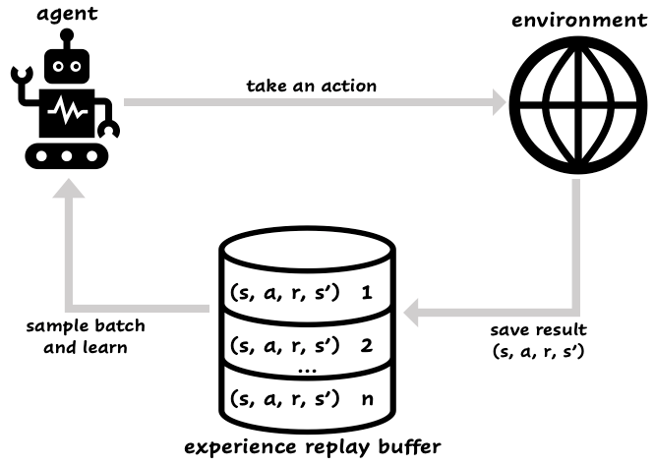
Deep Q-Learning Algorithm
DQN: Use a deep neural network to approximation Q-value
Replay Buffer Memory
Fixed Q-Target for Stabilization
Soft
update
Source
Source

Slide 12
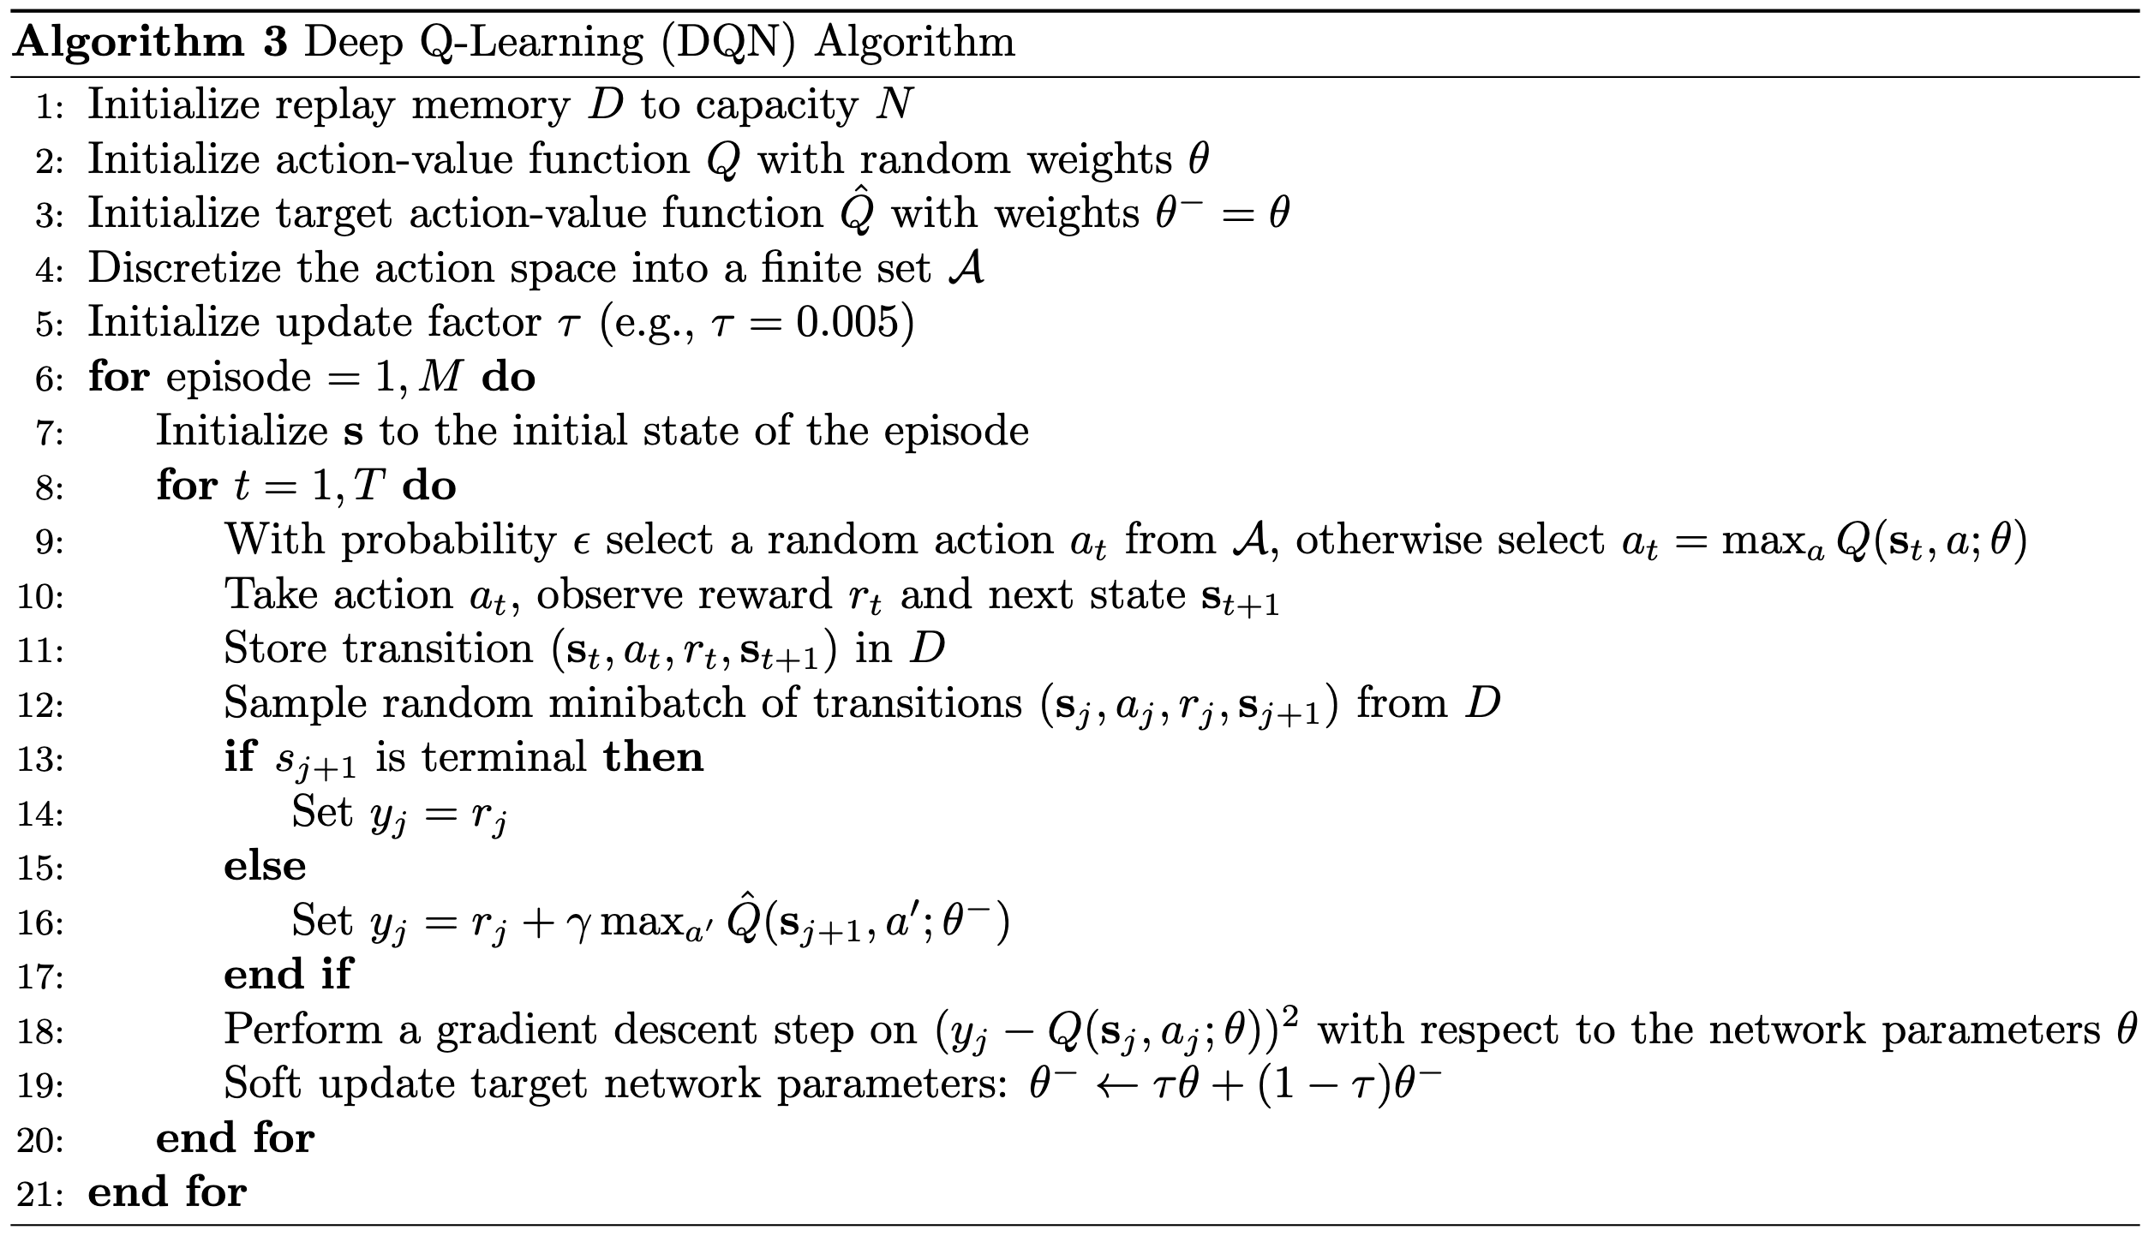
Deep Q-Learning Algorithm

Slide 13
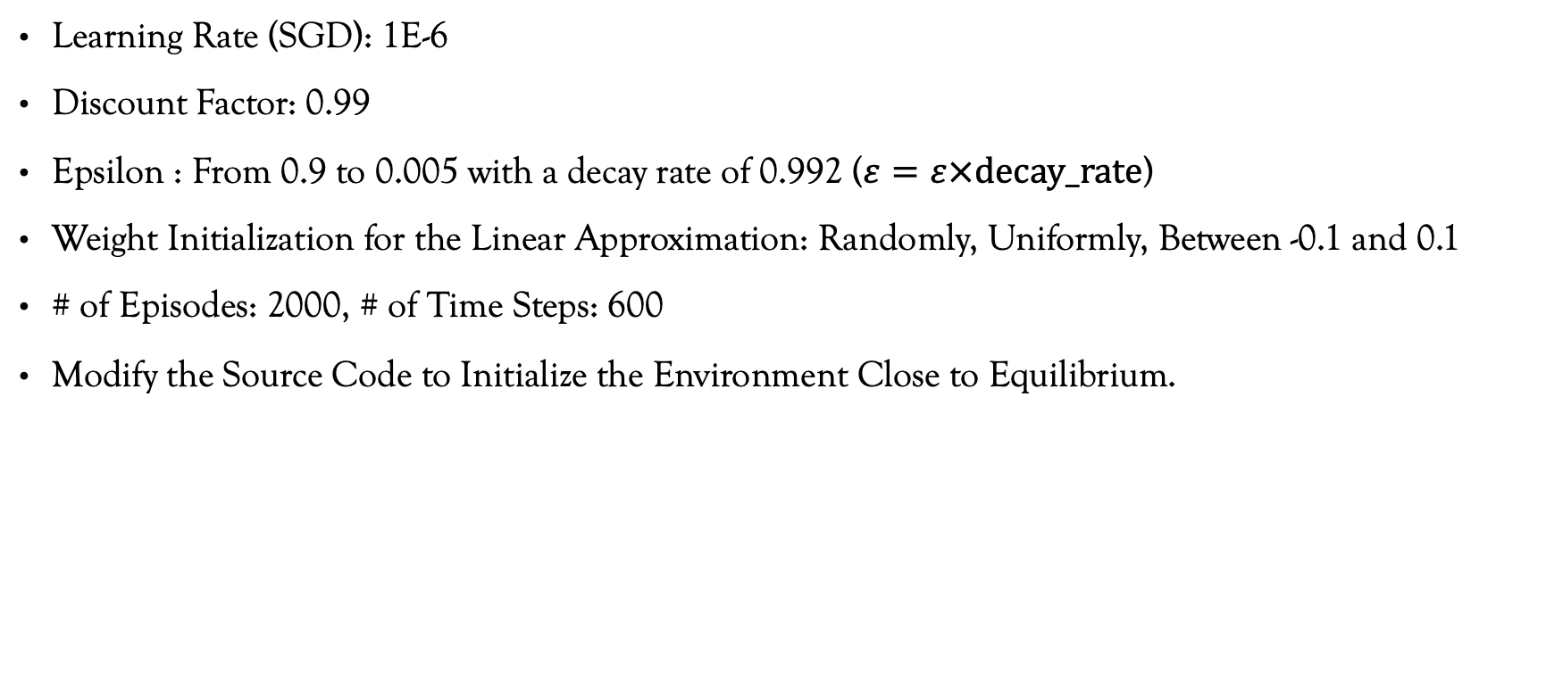
Results: Q-Learning (My Best Effort)
Learning Rate (SGD): 1E-6
Discount Factor: 0.99
Epsilon : From 0.9 to 0.005 with a decay rate of 0.992 ($ε=ε×decay_rate$)
Weight Initialization for the Linear Approximation: Randomly, Uniformly, Between -0.1 and 0.1
# of Episodes: 2000, # of Time Steps: 600
Modify the Source Code to Initialize the Environment Close to Equilibrium.

Slide 14
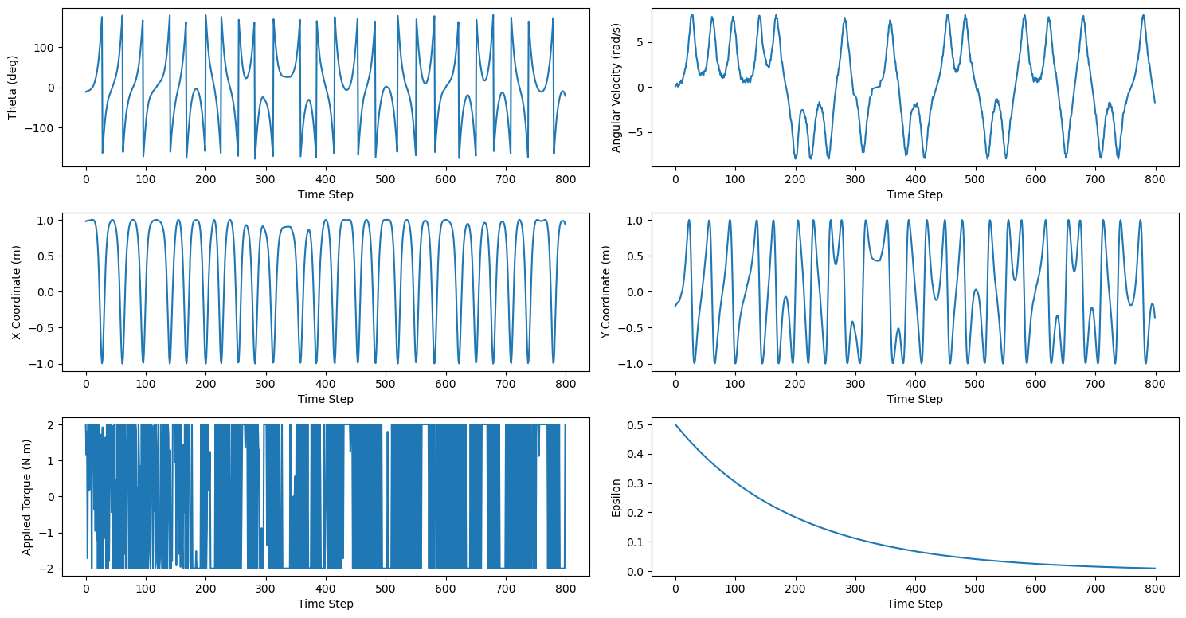
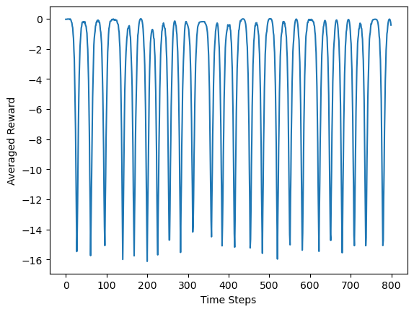
Results: Q-Learning (My Best Effort) Best Possible Result

Slide 15
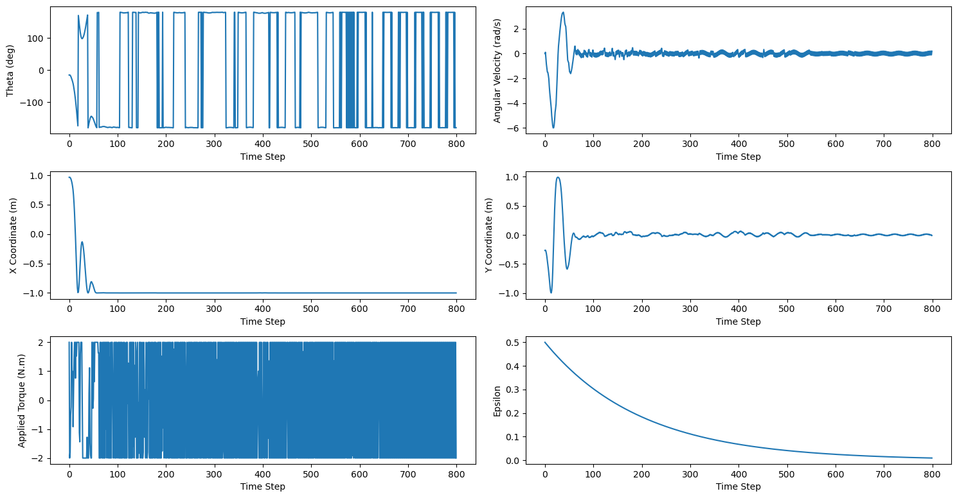
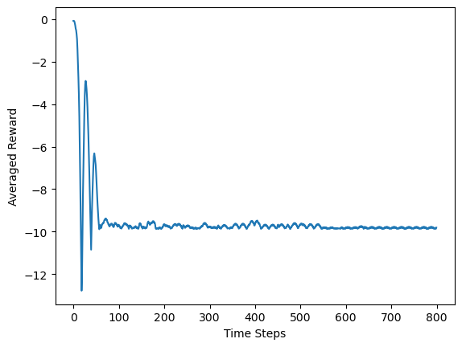
Results: Q-Learning (My Best Effort) Worst Case

Slide 16
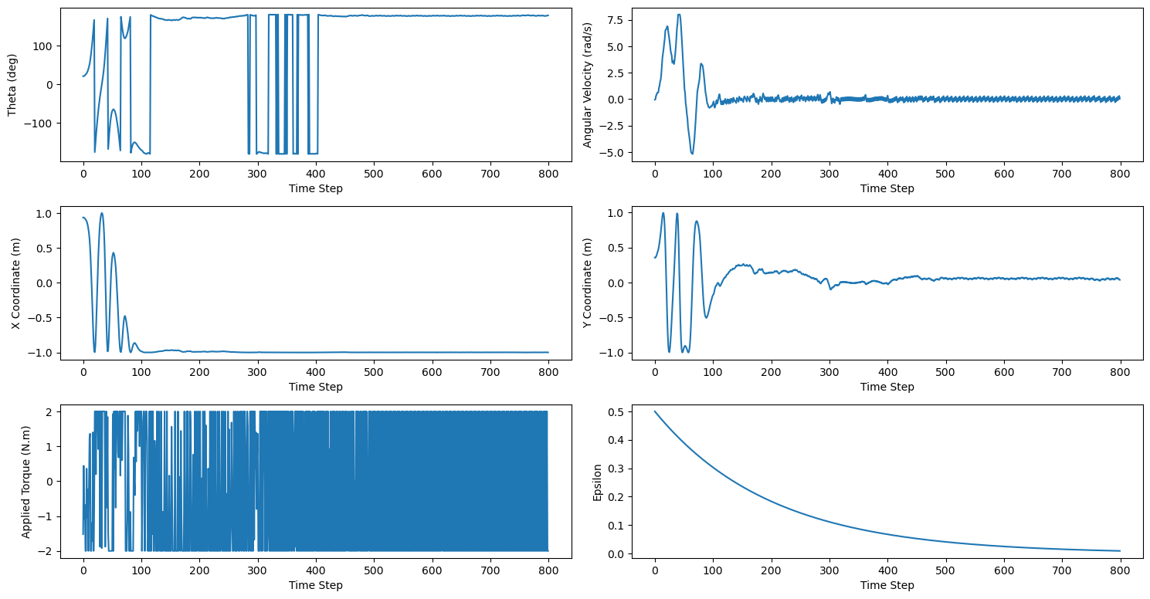
Results: Q-Learning (My Best Effort) Last Episode

Slide 17
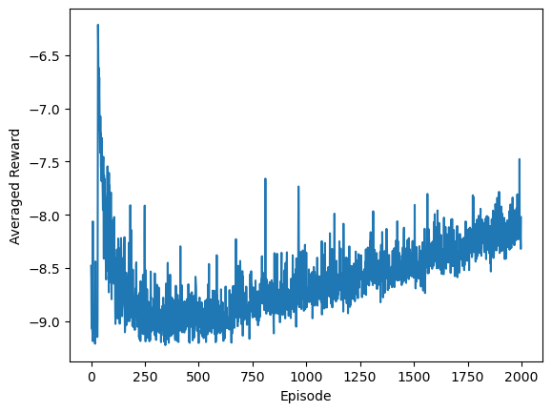
Results: Q-Learning (My Best Effort)
More episodes with longer duration could result into successful training.
Further hyper-parameter tuning could potentially lead to successful training.

Slide 18
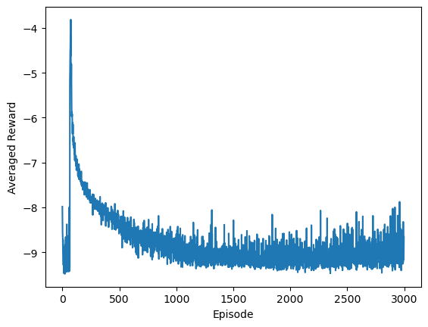
Results: Q-Learning (Slightly Different Hyper-Parameters)
Discount Factor: 0.97

Slide 19
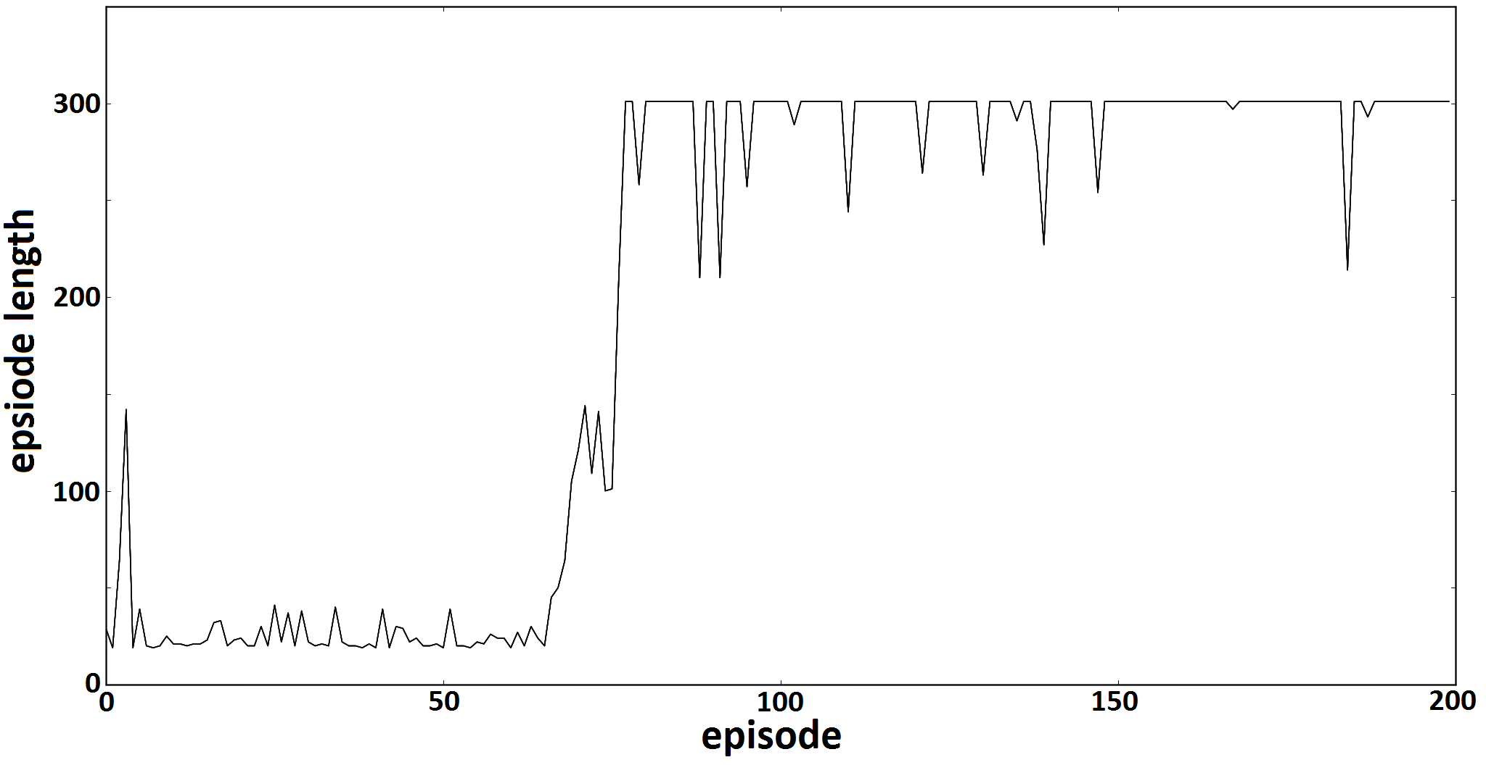
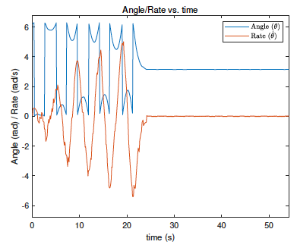
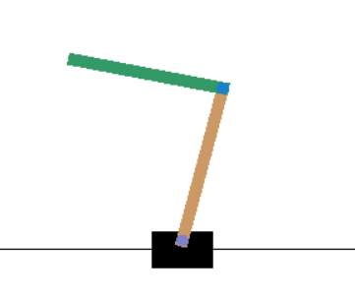
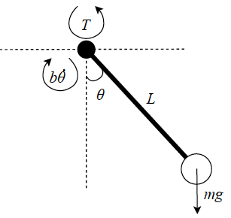
Results: Other Successful Examples
Gustafsson, 2016
Ghio and Ramos, 2018

Slide 20

Results: DQN (Successfully Trained!)

Slide 21
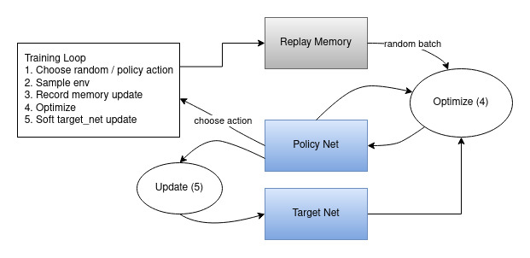
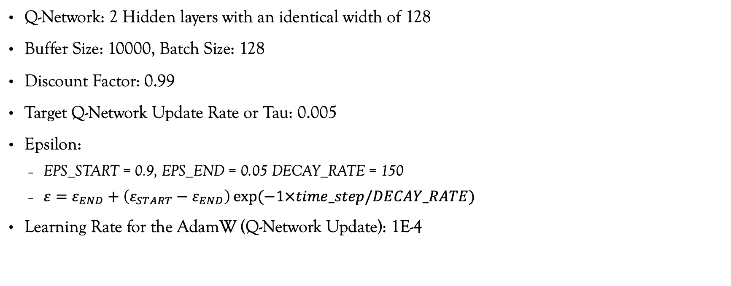
Results: DQN (Successfully Trained)
Q-Network: 2 Hidden layers with an identical width of 128
Buffer Size: 10000, Batch Size: 128
Discount Factor: 0.99
Target Q-Network Update Rate or Tau: 0.005
Epsilon:
EPS_START = 0.9, EPS_END = 0.05 DECAY_RATE = 150
$ε=ε_{END}+\left(ε_{START}−ε_{END}\right)\exp{(−1×time_step/DECAY_RATE)}$
Learning Rate for the AdamW (Q-Network Update): 1E-4
Source

Slide 22
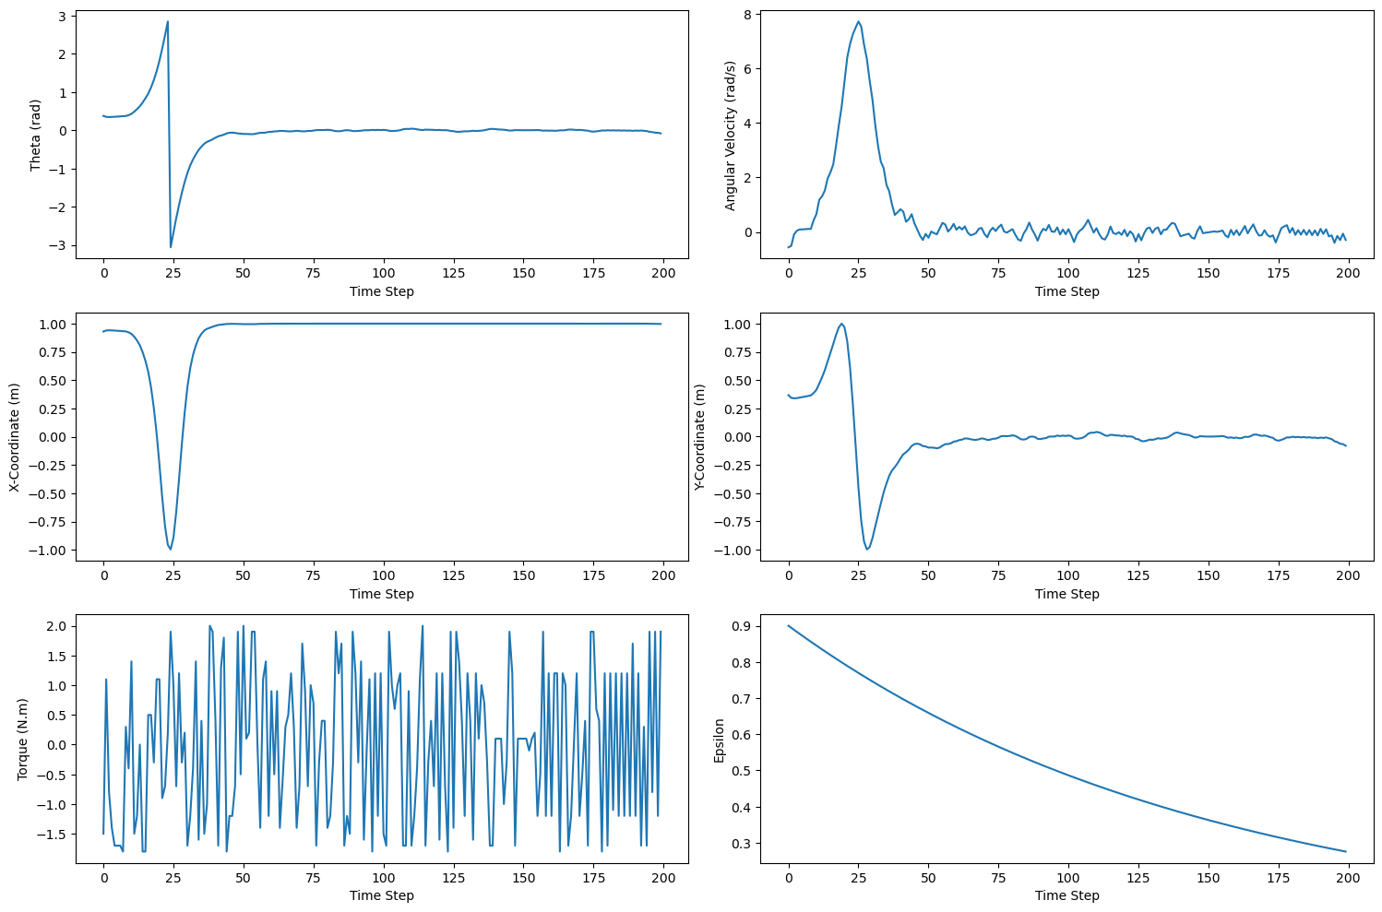
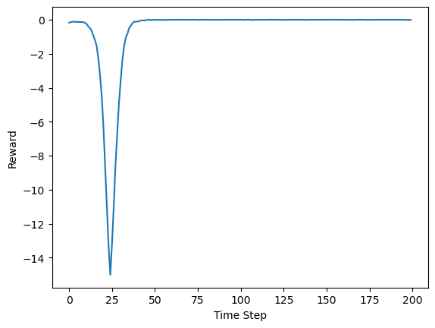
Results: DQN (Best Case)

Slide 23
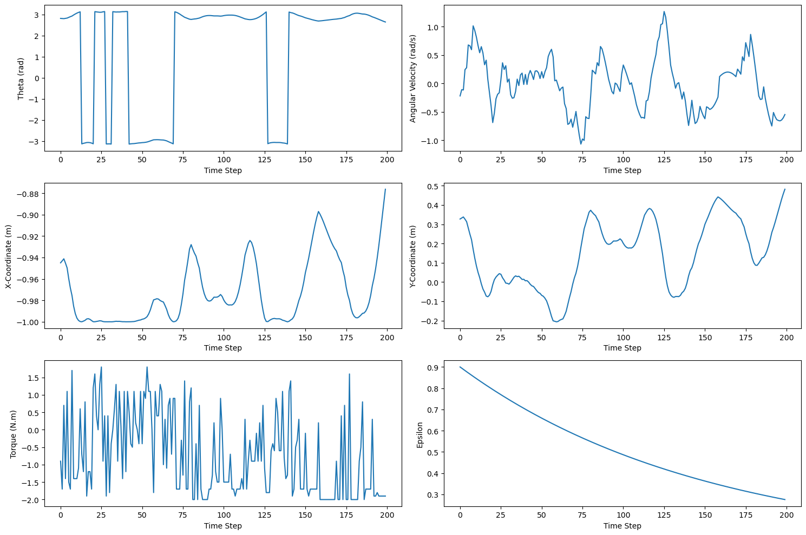
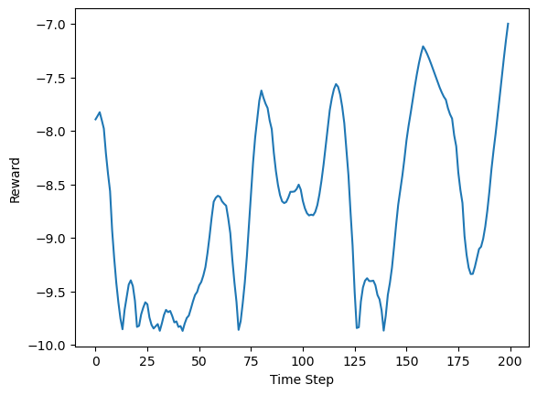
Results: DQN (Worst Case)

Slide 24
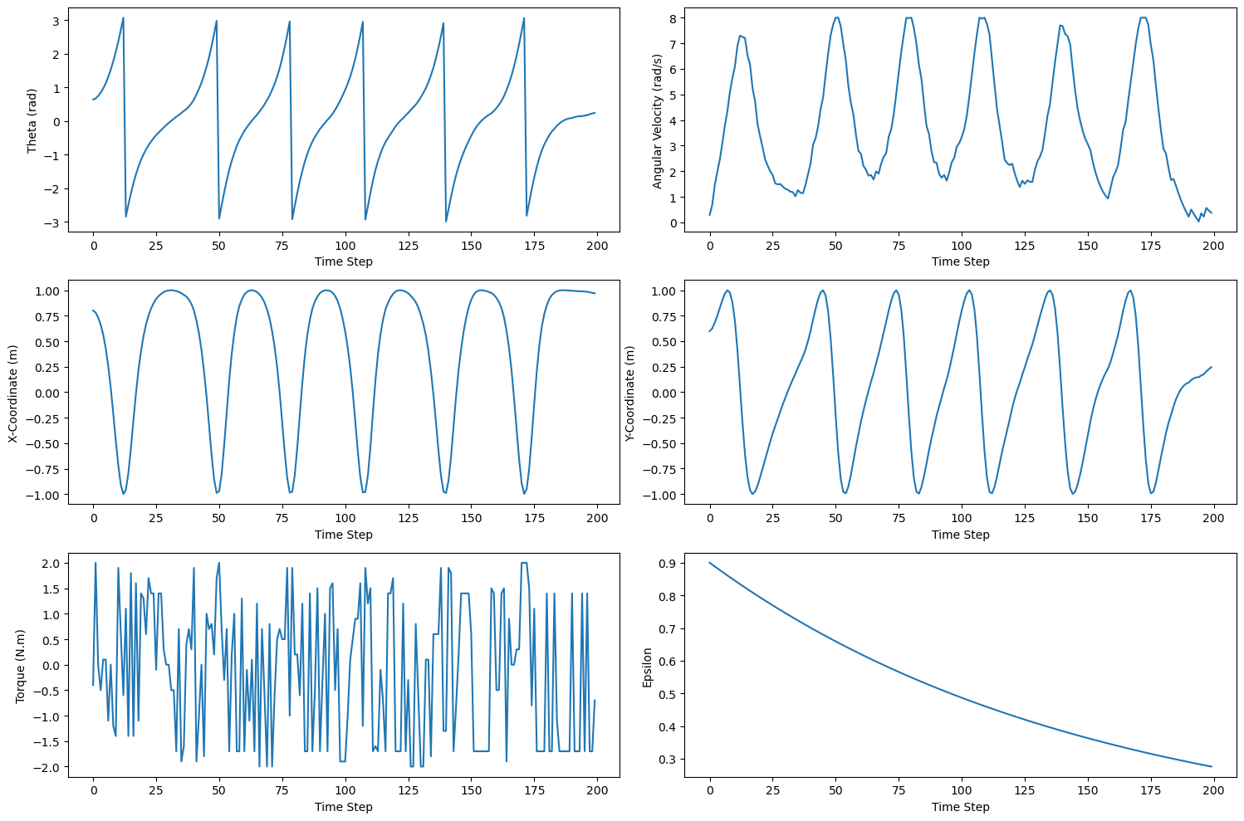
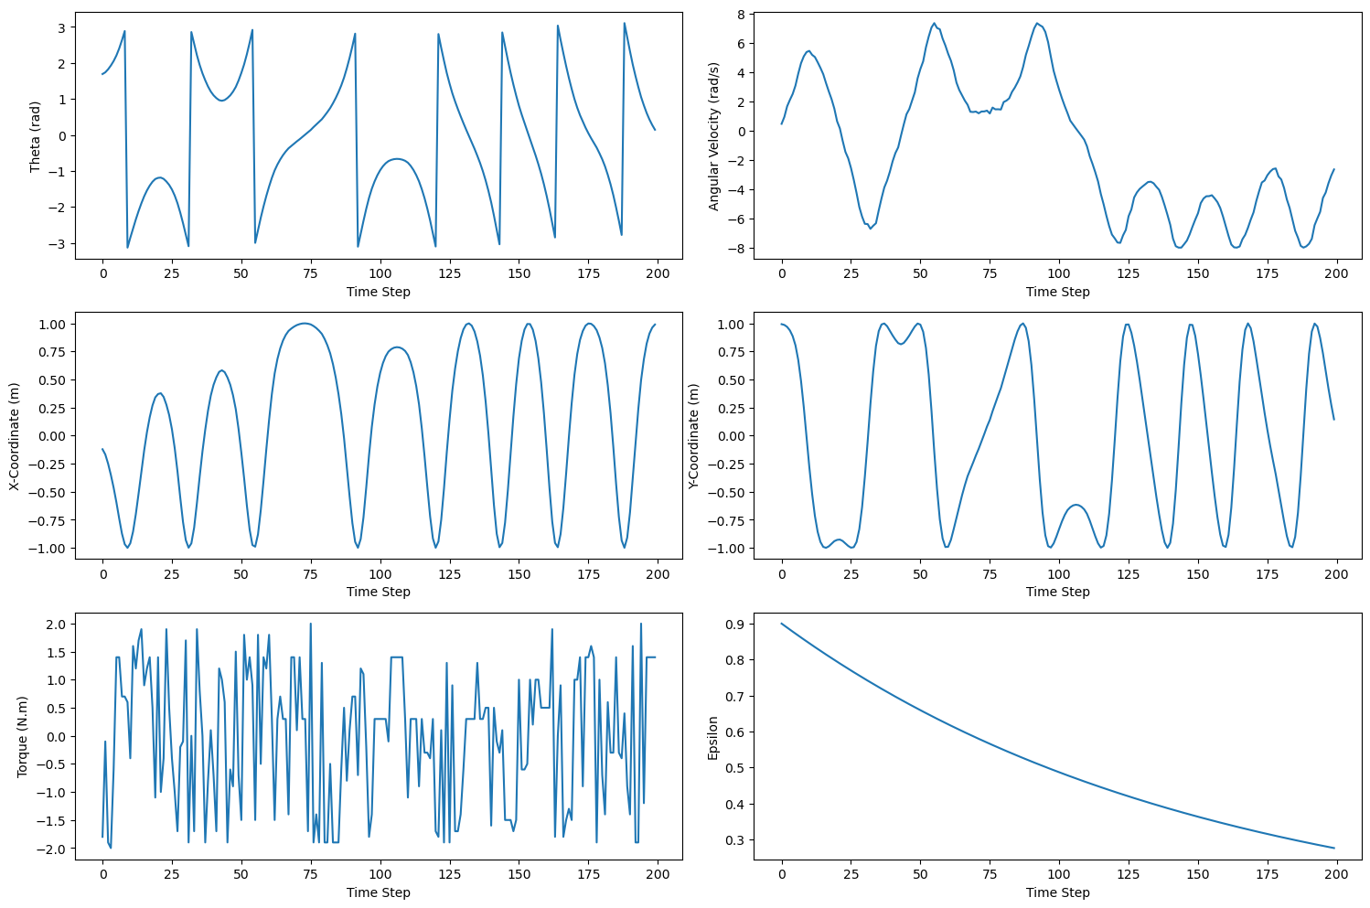
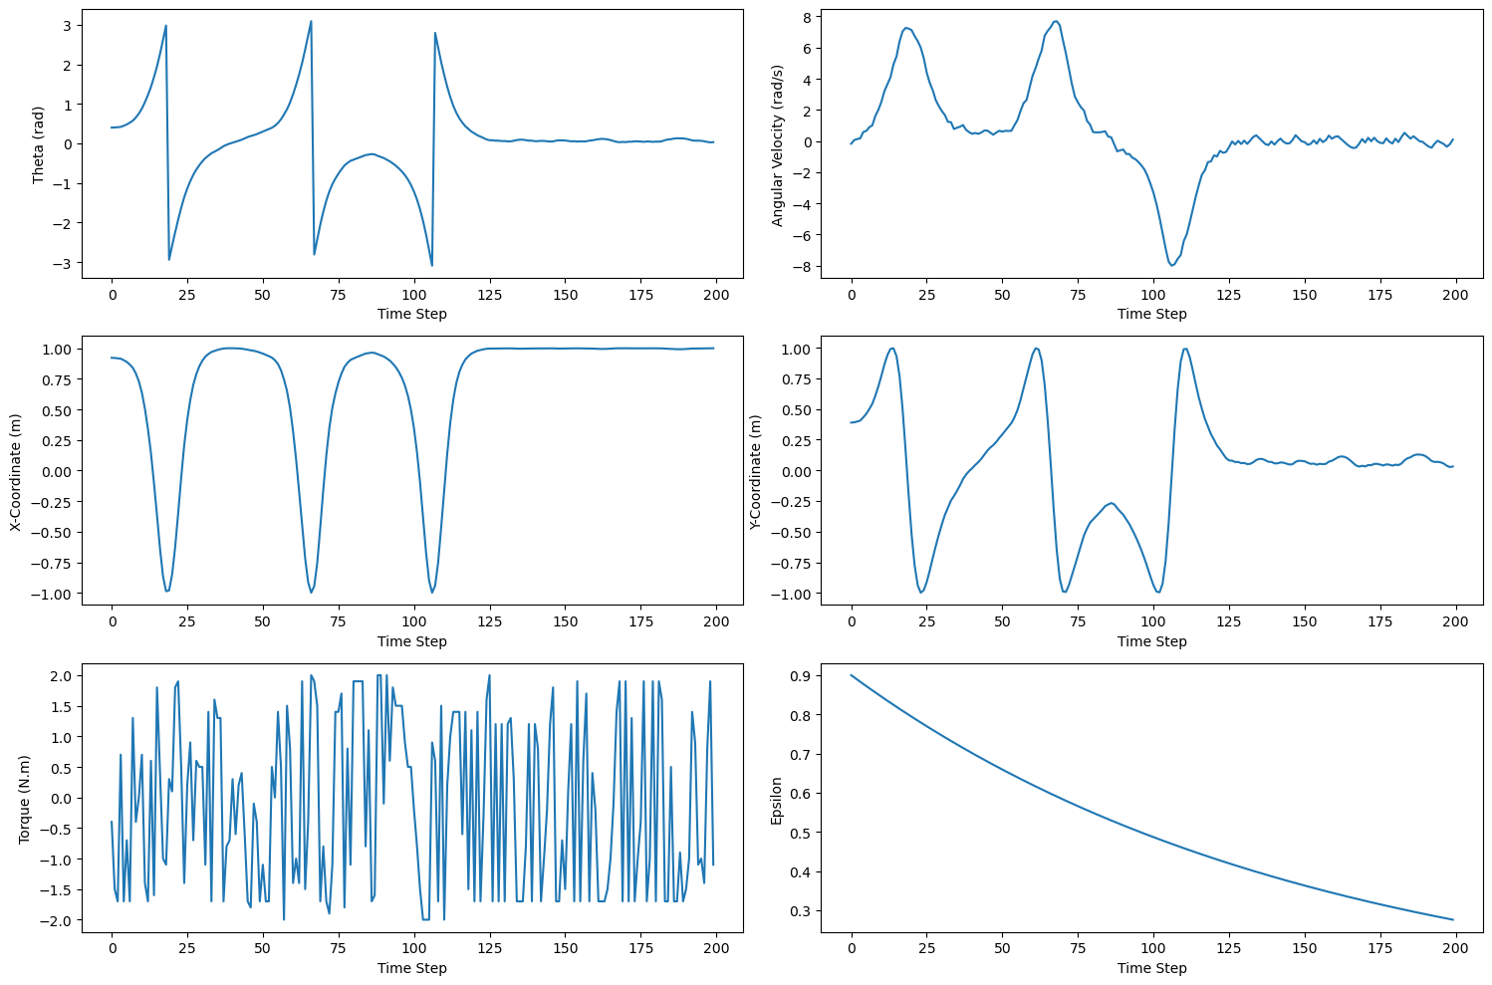
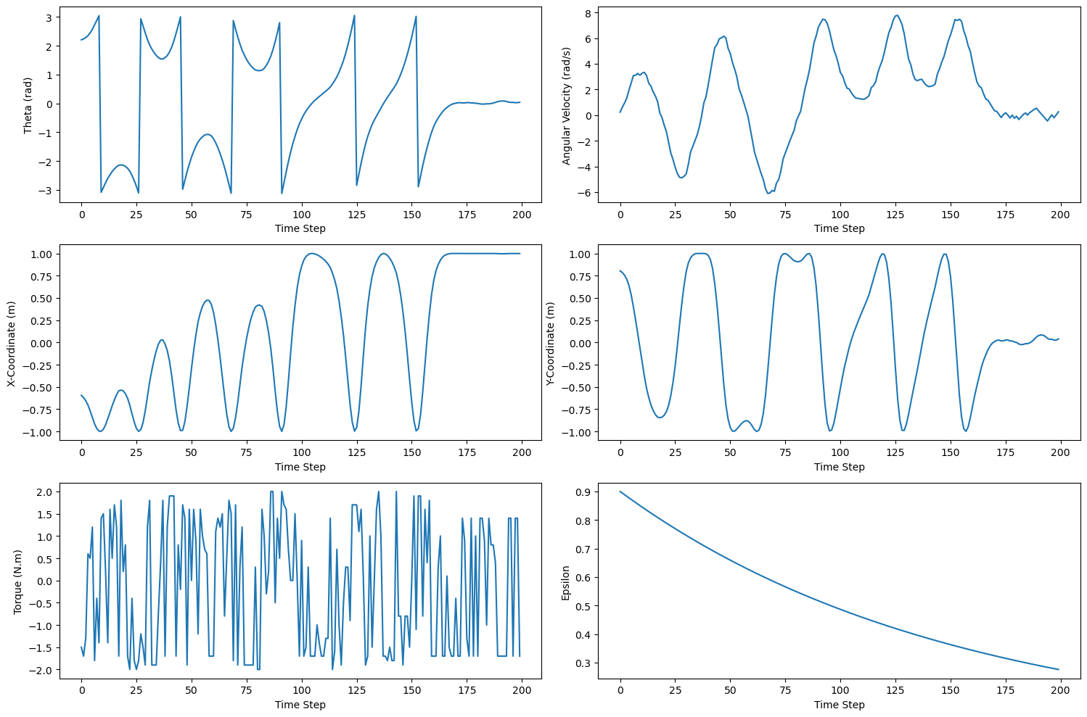
Results: DQN (Middle Episodes)
Episode: 300
Episode: 50
Episode: 100
Episode: 200

Slide 25
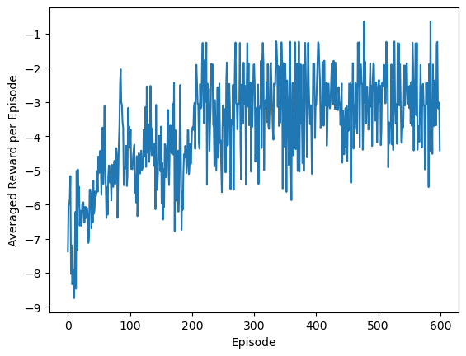
Results: DQN (It Learns!)

Slide 26
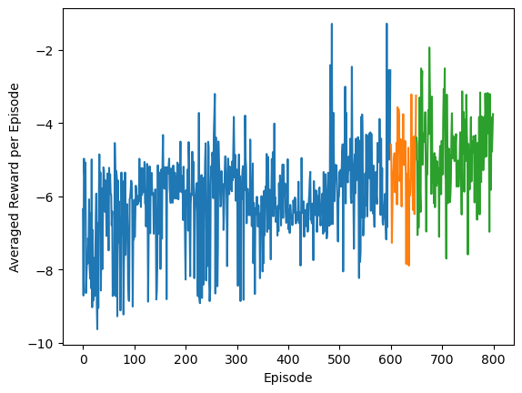
Results: DQN (Slower Learning)
Epsilon: From 0.9 to 0.05 with a decay rate of 75
Learning Rate for the AdamW (Q-Network Update): 1E-5

Slide 27
Results: DQN (Unsuccessful Training)
Q-Network: 2 Hidden layers with an identical width of 64
Buffer Size: 10000, Batch Size: 128
Discount Factor: 0.99
Target Q-Network Update Rate or Tau: 0.005
Epsilon: From 0.9 to 0.05 with a decay rate of 75
Learning Rate for the AdamW (Q-Network Update): 1E-5

Slide 28
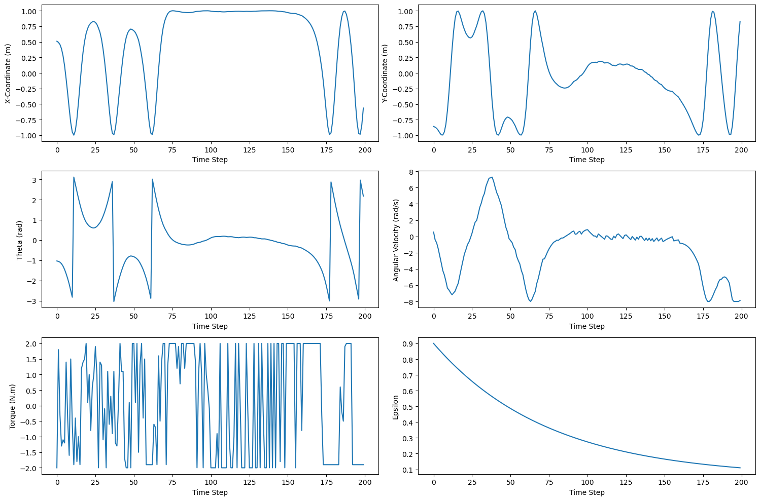
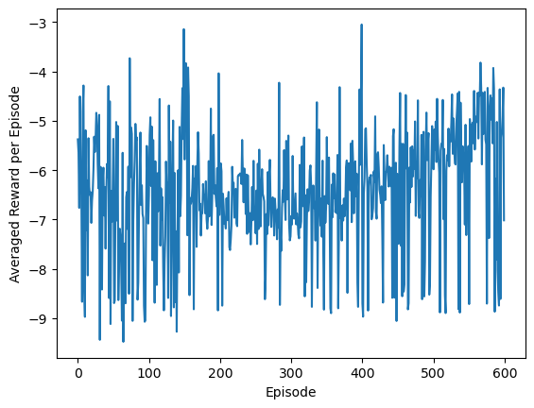

Results: DQN (No Learning)

Slide 29

More Complicated Algorithms
Deep Deterministic Policy Gradient:
Actor-Critic
Actor: Take Actions
Critic: Evaluate the Quality of Actions
Combination of Policy-Based & Value-Based Method
Actor: Policy-Based
Critic: Value-Based
Networks
Actor and Target Actor
Critic and Target Critic
Well-suited for Problems with Continuous Action Space
Output of the Actor Network is the Actual Action!
Source

Slide 30
References
1- Deep RL Course by Hugging Face Website:
https://huggingface.co/learn/deep-rl-course/en/unit0/introduction
2- David Silver Lecture Note: UCL Course on RL
https://www.davidsilver.uk/teaching/
3- Reinforcement Learning: An Introduction; Richard S Sutton and Andrew G Barto, 2018, MIT Press
chrome-extension://efaidnbmnnnibpcajpcglclefindmkaj/http://incompleteideas.net/book/RLbook2020.pdf
4- Q-learning-based Model-free Swing Up Control of an Inverted Pendulum; Alessio Ghio and Oscar E. Ramo, 2019, IEEE
5- Control of Inverted Double Pendulum Using Reinforcement Learning, Fredrik Gustafsson, 2016, Stanford University CS229

Slide 31
References
6- Reinforcement Learning (DQN) Tutorial:
https://pytorch.org/tutorials/intermediate/reinforcement_q_learning.html
8- Playing Atari with Deep Reinforcement Learning; Volodymyr Mnih et al., 2013, arXiv preprint, arXiv:1312.5602
7- Deep Deterministic Policy Gradient (DDPG) Tutorial:
https://keras.io/examples/rl/ddpg_pendulum/
8- Continuous Control with Deep Reinforcement Learning, Timothy P. Lillicrap et al., 2015, arXiv preprint, arXive: 1509,02971
9- https://github.com/fregu856/CS-229/tree/master
10- https://gymnasium.farama.org/environments/classic_control/pendulum/

Slide 32
Thanks a Bunch!
Any Question ☺ ?

